Slide 1
Case Writing Training

Slide 2
Content
Introduction
Building block 1: Concept
Building block 2: Content
Building block 3: Communication

Slide 3
Introduction to
Cases and Case Writing
Notes:
the decision focus and 6 Ws (who, what, where, when, why, and how)
just enough for case discussion: case study is not company history, use exhibits to enhance understanding
restating the issue and mapping out options facing the protagonist

Slide 4
What is a teaching case?

Slide 5
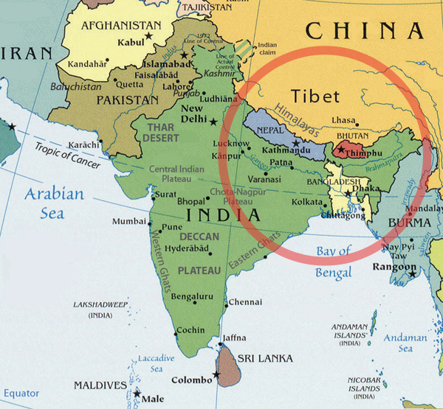

Slide 6


Slide 7
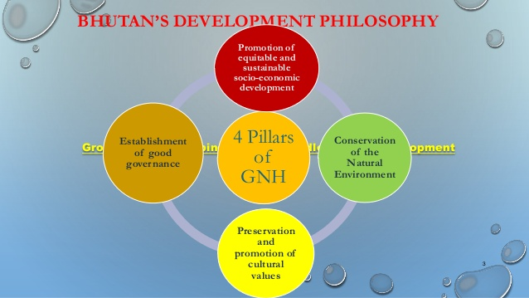

Slide 8


Slide 9
Reflections on slides 5-8
Slides 5-8 answer the question on slide 4: What is a teaching case? In order to write a teaching case, only the object (in this case the country of Bhutan), its background, structure, practices, etc. are not enough. One needs a story to develop the narrative and more importantly, a focal issue (e.g. dilemma) for students to discuss or exercise. Without these “actions”, a class case session would not be successful.

Slide 10
Main types of teaching cases
The descriptive case
The evaluative case
The exercise case
The decision case

Slide 11
What is a decision case?
A case is a description of an actual (or fictionalized) situation.
Often, it is a problem, a challenge, or a dilemma a decision-maker has to solve.
It bring the challenges of real-life situations into the classroom to engage students in stepping into the shoes of the decision maker.

Slide 12
What is a good case writer?

Slide 13

ART of storytelling
Notes:
Incomplete / biased info
Omit info, omit perspectives
What not to say is more important than what to say

Slide 14

ART of reverse engineering
Notes:
A teaching case is the later stage of a research case
Write teaching note outline first – what kind of case is it? finance/hr …, objectives 3-5, for who [undergrad, grad, exe], questions [what theories to use, reading],

Slide 15
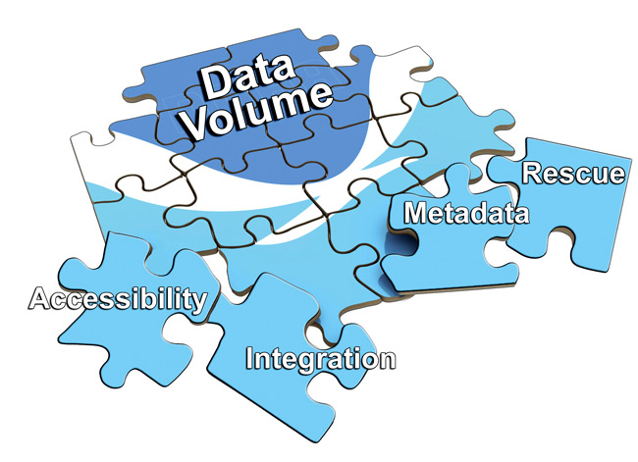
ART of data management
Notes:
Informative
Fun read
Learning – layers

Slide 16

The hallmark of a good case writer is to explain a highly technical subject in a non-technical way.
Notes:
Not write for 5 people, but a broad audience.
Readers won’t be picky as reviewers – goal is not to prove you’re right / accurate, but to intrigue them / get them excited, do the thinking/work

Slide 17
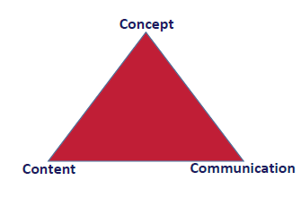
The 3 C’s of Case Writing
Notes:
Incomplete / biased info
Omit info, omit perspectives
What not to say is more important than what to say

Slide 18

Exercise: write a detective story “Who has done it?”

Slide 19
How to use slide 18?
The purpose of this exercise is for students to practice to embed a concept in a narrative and tell the story in a convincing way. The instructions on the exercise is given in the Case Writing Curriculum appendix 2.
After the exercise, the instructor can ask students to reflect on the following questions:
Which is more difficult? Decide who did it, how he did it and why he did it, or embed the clues in the story?
Did you give any false clues or deliberately try to mislead your audience?
Did you go back and forth in time in your story?
Is your story the right level for your audience?
Does the writing process excite you?

Slide 20

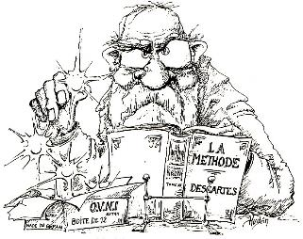
Research case
description
explanation
faithfulness
chronological
no perspective(s)
little or no drama
Teaching case
story
in the teaching note
some highlighted other omitted
not always
protagonist(s)
preferring drama and controversy
Notes:
You’re writing for many strangers, not for peers.

Slide 21
Building Block 1:
CONCEPT

Slide 22


Slide 23
The first step of writing a case is to think
About the teaching note:
Who is this case for (study, level)?
What are my teaching objectives (3-5 points)?
What are the key discussion questions or topics (5-7)?

Slide 24
Decision case
Evaluative case
Exercise case
Descriptive case

Slide 25
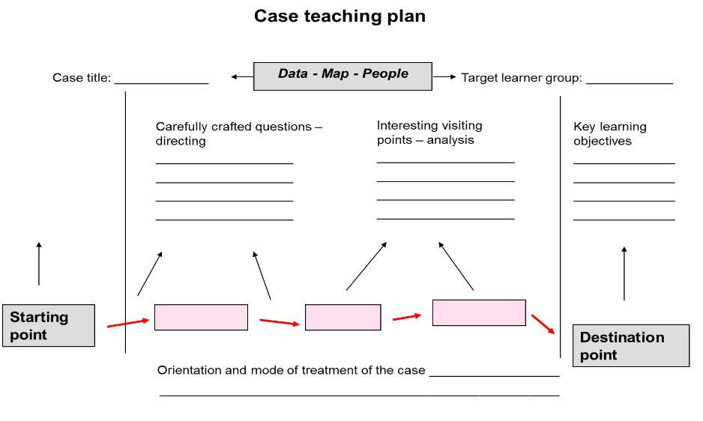
Notes:
Mode: point of view (manager, consultant, etc)
Treatment: Inductive, deductive, Invergent, divergent

Slide 26
Essentials to a case
Decision maker (protagonist)
Decision focus
Time point
Action trigger
Notes:
Timing:
HousingAnywhere – beginning how to expand internationally, insufficient users, financing attract investors
Dacom: hire the person – whether I shall hire him, already hired not deliver- whether I shall fire him, after firing what kind of sales person should I hire – me/my daughter/…?
Fairphone: 1. from campaign to phone what to do? 2. made the phone, how keep costs low and socially responsible? 3. circular economy, how to implement?
Multiple protagonists: HBR (his & her version), German nuclear powerplant (shareholders – pension funds, regional government, employees)

Slide 27

Decision maker - Protagonist
Has the initiative: can make decisions and take actions
Has the consequence: have a stake in his/her decisions
The audience identifies with
It doesn’t always have to be a leader / manager
Multiple decision makers, but choose one to focus on
Notes:
Give out the exercise for case focus

Slide 28
Decision focus
Critical decision moment
Often a dilemma (the lesser of two evils)
A sequel of decision moments, choose the most recent one
Notes:
Give out the exercise for case focus

Slide 29
Time Point: the decision moment

Slide 30


Action trigger
What if my protagonist didn’t make a decision?
What if he/she delayed the decision?
External or internal reasons?

Slide 31
Case essentials example
The Italian family firm AFG bought a defective plant in 2009 when it decided to expand business. AFG’s owner, Mauro Polano, had to decide whether to (1) invest in a new plant to make up for the under-promised capacity of the current one (2) stop production for two months, repair the plant, and fix all defects or (3) sell the flawed plant and stop expansion. Each option had its own risks and long-term consequences for the business as well as the family. What should Mauro do?

Slide 32
Case essentials example
The case serves two main teaching objectives:
To make students understand the characteristics of a family firm – the “mission” of the entrepreneur is often to provide a secure future for his family.
To make students examine the dilemma common to many entrepreneurs – how should one deal with setbacks when building or growing a company, especially when a large investment has already been made? This question tackles the question of sunk costs faced by many companies and managers.

Slide 33

Exercise: case pitch
Create a snapshot of a case situation that covers all the 4 essentials, and serves your teaching objectives.

Slide 34
Building Block 2:
CONTENT

Slide 35

Data source
Field research (field case)
Published source (library case)
Generalized experience (armchair case)

Slide 36
Source: The Case Centre statistics 2016

Slide 37
Getting in touch with the company
What’s in it for me?
Enhance brand name
Improve organizational learning
Aid managerial decision making
Contribute to education / own school
How much time will it cost me?
4-8 hours of interviews (depending on the number of interviews)
2-4 hours of reviewing drafts
What about confidentiality?
Make clear the boundaries (for teaching and research)
Sign a NDA (non-disclosure agreement)
Won’t make the case public until the company signs off
Disguise identities and financials

Slide 38
Interview techniques
Do homework
State your aim clearly
Ask permission to record
Create a safe and relaxing environment
Prepare a semi-structured interview guide
Ask closed and open-ended questions
Be a good listener
Make no judgments
Take control of time and direction
Be ready to improvise
Check understanding by reformulating
Be culturally sensitive
Transcribe ASAP

Slide 39
Standard components of a teaching case
The opening section
Company and industry background
The case story
The closing section

Slide 40
Timeline structure

Slide 41
Timeline structure
What happened before each event?
What happened in parallel?
What happened after?
Cause and effect
Notes:
Timing:
HousingAnywhere – beginning how to expand internationally, insufficient users, financing attract investors
Dacom: hire the person – whether I shall hire him, already hired not deliver- whether I shall fire him, after firing what kind of sales person should I hire – me/my daughter/…?
Fairphone: 1. from campaign to phone what to do? 2. made the phone, how keep costs low and socially responsible? 3. circular economy, how to implement?
Multiple protagonists: HBR (his & her version), German nuclear powerplant (shareholders – pension funds, regional government, employees)

Slide 42

Spatial structure

Slide 43
Spatial structure
Things happen in a relatively shorter timespan or simultaneously
Pieces of information / aspects of views that contribute to a complete picture

Slide 44
Exercise: analyse two structures
The following 2 movies are both about the start of the global financial crisis. Watch the trailers below and answer which uses the timeline structure and which uses the spatial structure, and why.
The Big Short https://youtu.be/LWr8hbUkG9s
Margin Call https://youtu.be/IjZ-ke1kJrA

Slide 45
Common structure for a case
A mix of timeline and spatial
Overall structure timeline: present – past – future
(prospective, retrospective, prospective)
Body structure spatial: data of all aspects relevant to the case, arranged from general to specific (funnel shape)

Slide 46
Exercise: create a structure
Go back to the detective story you wrote.
If you used the timeline structure, retell it with the spatial structure, and vice versa.
You may also choose a mixed structure.

Slide 47

Exercise: write your case structure

Slide 48
The opening section
Set the scene
Introduce the protagonist(s)
Introduce the issue
Get readers interested

Slide 49
Exercise: analyze case openings
You are given 4 very different case openings (see Case Writing Curriculum appendix 3). Read them through and answer:
Which opening(s) attracts you to read on and which one(s) does not?
Why? Give your detailed analysis.
How would you improve these openings?
Notes:
handout: case focus & synopsis

Slide 50
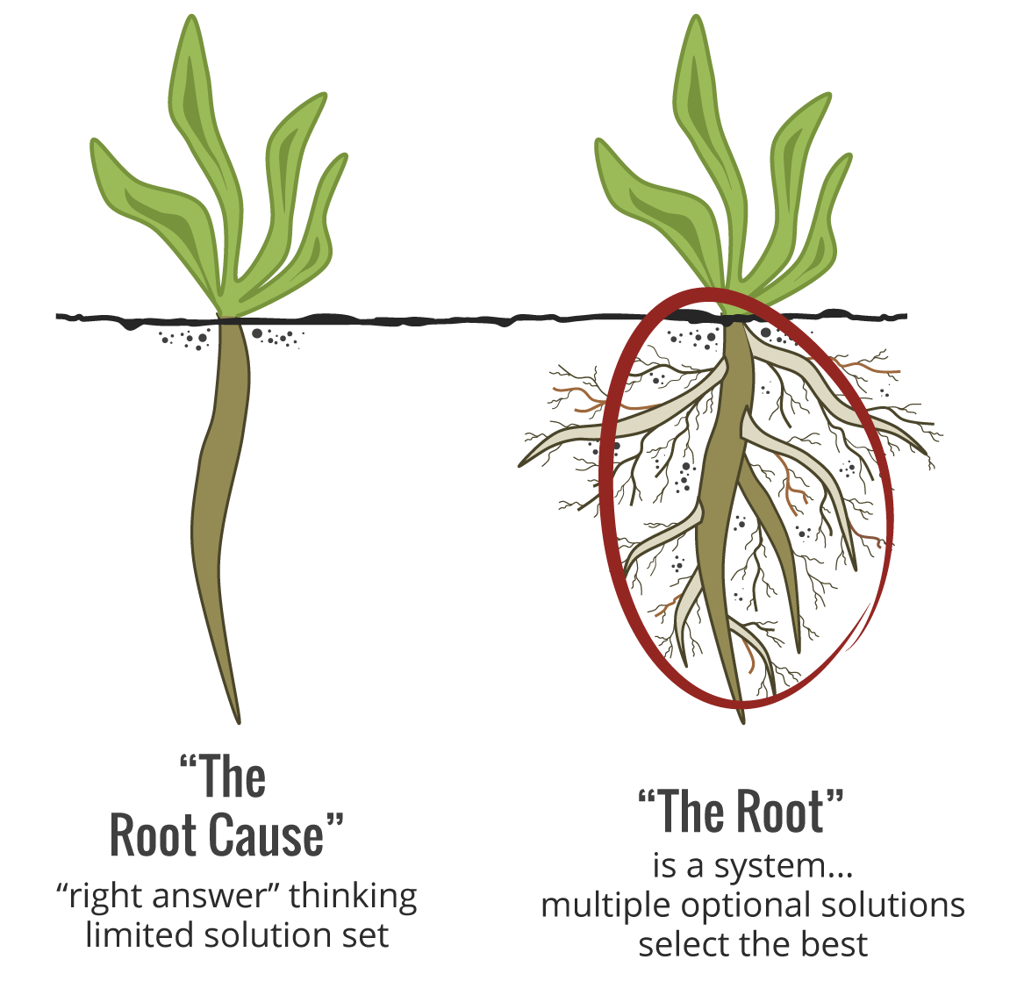
The opening section
immediate issue: direct, apparent, urgent
root issue: deep, fundamental, “root cause”

Slide 51
The opening section checklist
Is the decision maker identified by name and position?
Is the time of the case clear?
Is the location of the organization identified?
Is the issue, decision, problem or opportunity clearly identified and sufficiently interesting?
What is the action trigger?
Is it too long?
Is it too short?
Is it cliché? (e.g Smith paced back and forth in his office / leaned back in his chair and pondered… )

Slide 52

Exercise: write your opening section

Slide 53

The teaching note
Synopsis
Teaching objectives
Target audience
Teaching plan (with a time plan)
questions to prepare students for the discussion
questions to open the discussion
questions to advance the discussion
questions to close the discussion
give answers (directions) and analyses to each question, analyses should always link back to the case
Classroom feedback
References and recommended readings/links
Notes:
always need to teach 1 or 2 times to refine the teaching note and case

Slide 54

Teaching objectives
Use precise verbs
Remembering: define, duplicate, list, recall, repeat, reproduce
Understanding: classify, describe, explain, identify, locate, select, translate, paraphrase
Applying: choose, demonstrate, employ, illustrate, operate, sketch, solve, write
Analyzing: compare, contrast, criticize, differentiate, examine, experiment, question
Evaluating: appraise, argue, defend, judge, evaluate
Creating: assemble, construct, design, develop, formulate, write

Slide 55

Exercise: review teaching objectives and discussion questions
Are they the same as what you brought to the classroom?
Are you using precise verbs for the teaching objectives?
Expand the teaching note outline or map

Slide 56
Building Block 3:
COMMUNICATION

Slide 57
Source: The Case Centre statistics 2016

Slide 58

Case writing style
Objective, maintain authority
Concise, direct
Avoid jargon and technical terms
Try to keep paragraphs and sections to a reasonable length
A paragraph covers one point
Be careful with details (only when you want to emphasize)
Not too many quotes
Quotes not too long (judgemental/emotional phrases in quotes; show personality; permission to use them)
Avoid repetitions
Provide no analysis or lessons learned
Short case preferred (no more than 5000 words)

Slide 59
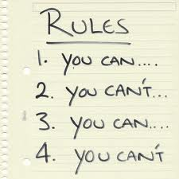
Case writing conventions
Past tense
Refer to actors by last names
Don’t capitalize position titles
Use headings and sections titles
Number exhibits and refer to them within the text at appropriate points
Using appendices for information not part of the case story

Slide 60

Edit the case
Work backward from teaching objectives, discussion questions and potential solutions. Does the case include enough material to address them?
Is there enough information to support multiple interpretations?
Is the shape or direction of the case always clear? Or is it muddied by needless detail?
Is the text easy to read?

Slide 61
What makes a good teaching case?
A case, not just a story
Fresh topic
Relevant, important issue
Objective, in perspective
Just enough information (red herrings)
Broad enough to allow generalization
Specific enough to allow thorough exploration
Personal touch
Contrasts, tensions, controversy, or other dramatic elements
Well structured and easy to read
Have layers (immediate and root issues)

Slide 62

What makes a popular case worldwide?
Cases with a simple and clear focus
A hot topic with broad relevance
Shorter cases (10 pages or fewer)
Cases about emerging economies
Cases besides teaching notes that also have concrete assignment questions or exercises
Role plays and exercises (instructions have to be very clear).
www.thecasecentre.org

Slide 63
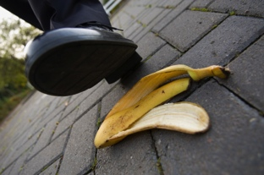
Case: common pitfalls
No clear focus
Too much detail
Lack of structure
Lack of context
Unspecified actors
No controversy
Many jargons
Acronyms not spelled out
Theories in the case

Slide 64

Teaching note: common pitfalls
Skimpy
Too general teaching objectives
Too many or too few teaching objectives
Case analysis doesn’t match case content
Case analysis copy & paste from the case
Not enough open or closed questions
Not enough controversial questions
Discussing a theory without a purpose
No answers, pointers, or analytical tools provided

Slide 65

Don’t Use
occurrence
infrequent
in view of that
a majority of
take into consideration
orientated
preventative
basic principles
consensus of opinion
personal opinion
Use
event
rare
since
most
consider
oriented
preventive
principles
consensus
opinion

Slide 66

Case release
Obtain company written authorization before submitting the case and teaching note for release
Notes:
You can get an example of the case release document from CDC. We are happy to help you obtain the release.

Slide 67
Sources
Abell, Derek. 1996. “What Makes a Good Case?” IMD.
Farhoomand, Ali. 2004. “Writing Teaching Cases: A Quick Reference Guide.” Hong Kong: CAIS.
Gentile, Mary. 1990. “Twenty-Five Questions to Ask as You Begin to Develop a New Case.” Harvard Business School.
Linder, Jane. 1990. “Writing Cases: Tips and Pointers.” Harvard Business School.
Roberts, Michael. J. “Developing a Teaching Case (Abridged).” 2001. Harvard Business School.
Strunk, William, Jr., and E. B. White. 2000. The Elements of Style. 4th ed. New York: Longman.
Zinsser, William. 1990. On Writing Well: An Informal Guide to Writing Nonfiction. 4th ed. New York: HarperCollins.

